Slide 1
Let’s do a bit of memory
Name the Objects

Slide 2



Name the Objects

Slide 3
Name the Objects

Slide 4
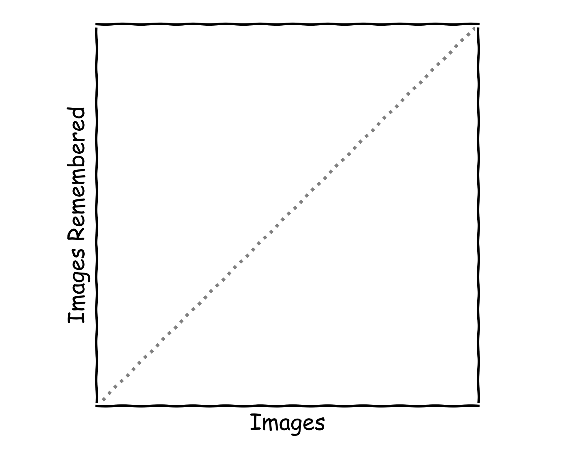
Memory Graph

Slide 5






Name the Objects

Slide 6
Name the Objects

Slide 7
Memory Graph

Slide 8










Slide 10
Memory Graph

Slide 11





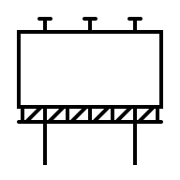




Slide 13
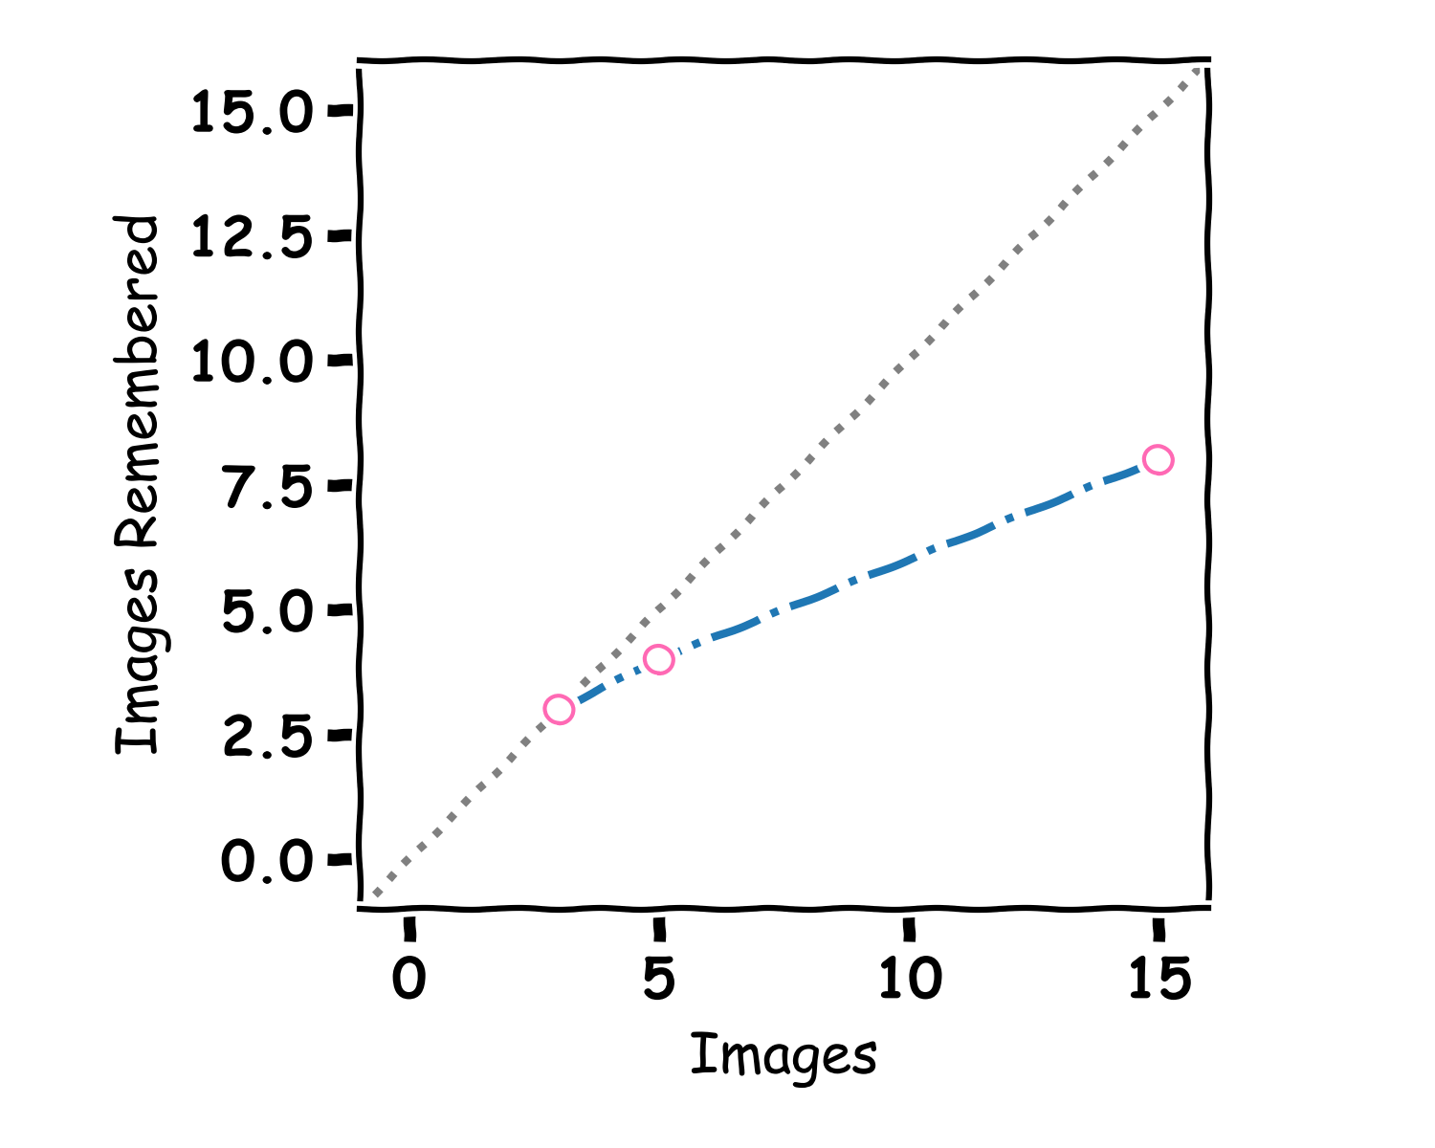
Memory Graph

Slide 14
A bit of Walking

Slide 15
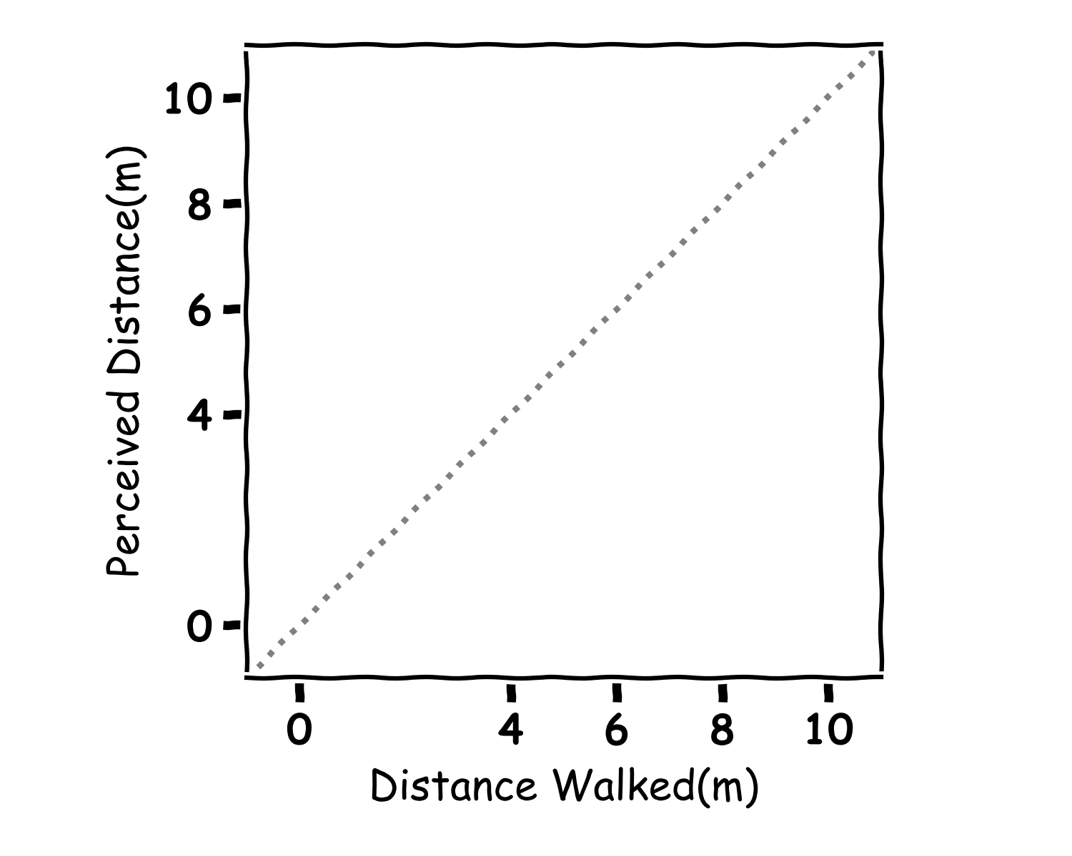
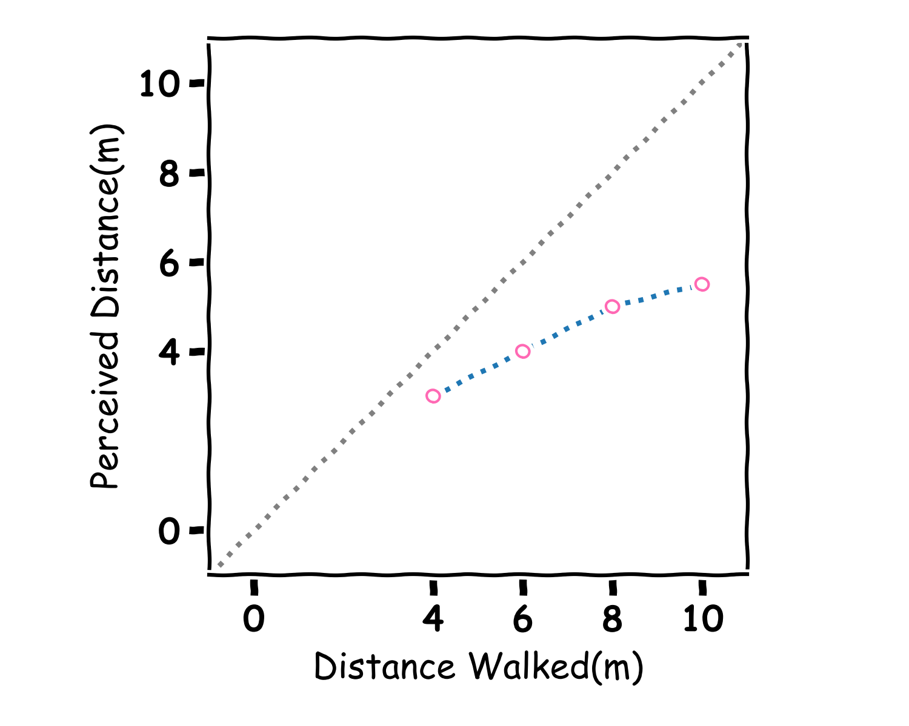
Walking Graph

Slide 16
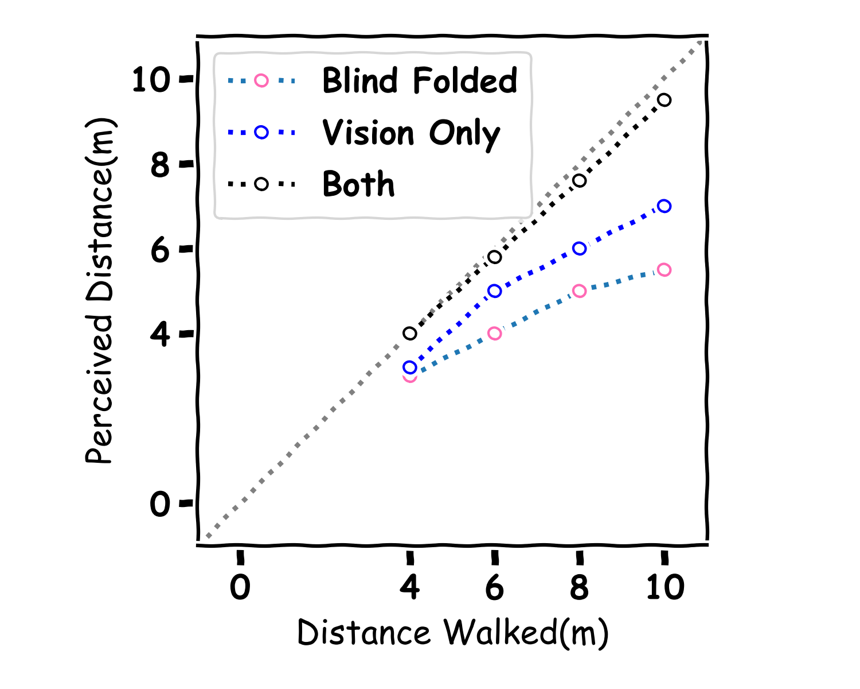
Walking Graph

